Slide 1
Landmark Recognition
Jifu Zhao
04/26/2018, Urbana

Slide 2
Introduction

Slide 3
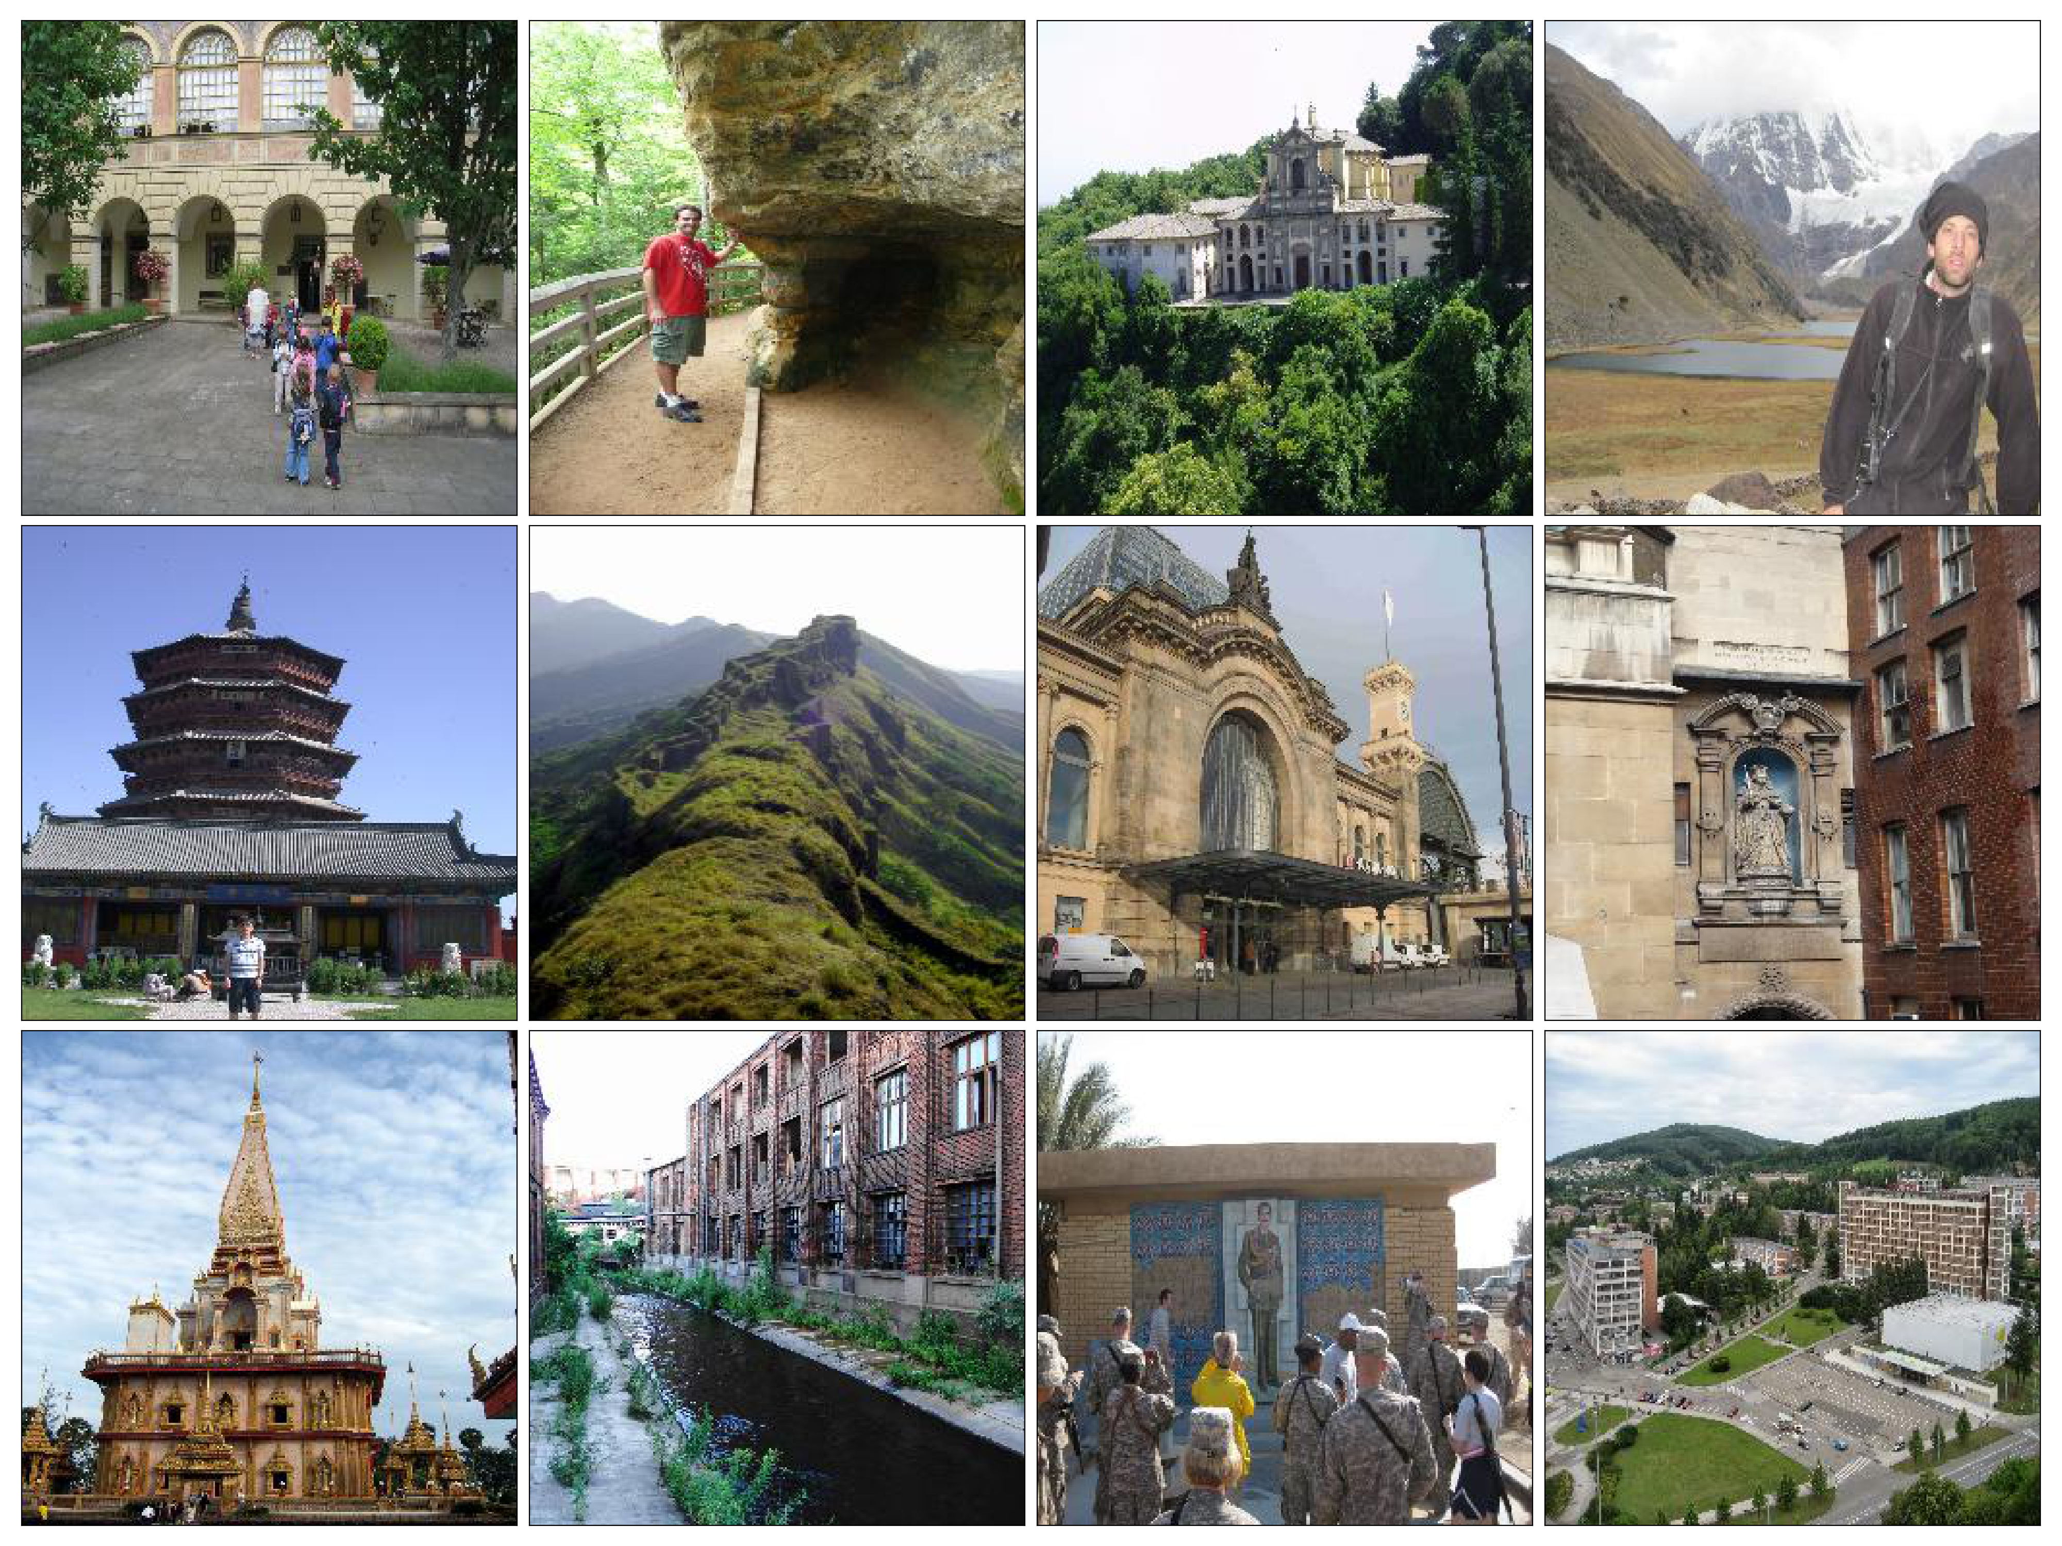
Data

Slide 4
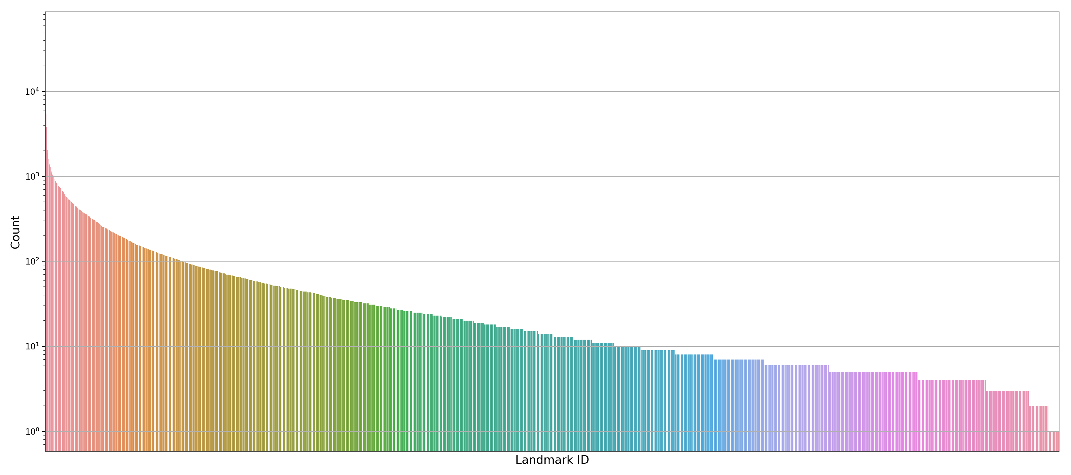
Data

Slide 5
Data

Slide 6
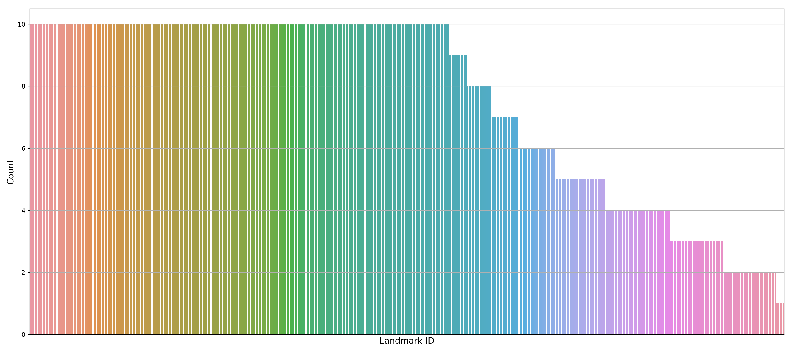
Data

Slide 7
Methodology

Slide 8
Random Guessing

Slide 9
Classical Multiclass Classification

Slide 10
Siamese Network
Output
Similarity
Output A
Output B
Neural Network
(e.g. CNN)
Neural Network
(e.g. CNN)
Shared Weights
Input A
Input B

Slide 11
Triplet Loss
Learning
Negative
Negative
Anchor
Anchor
Positive
Positive

Slide 12
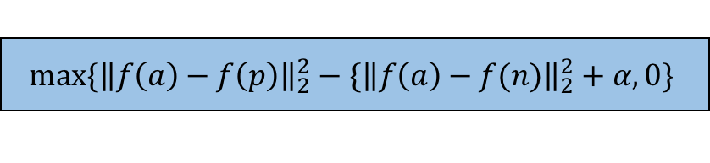
Triplet Network
Triplet Loss
$$max⁡\{{\left\|f\left(a\right)−f\left(p\right)\right\|}_{2}^{2}−\{{\left\|f\left(a\right)−f(n)\right\|}_{2}^{2}+α, 0\}$$
f(a)
L2
L2
L2
Neural Network
(e.g. CNN)
Neural Network
(e.g. CNN)
Neural Network
(e.g. CNN)
Shared Weights
Shared Weights
Input a
Input p
Input n

Slide 13
Triplet Network

Slide 14
Triplet Network

Slide 15
Training

Slide 16
Results

Slide 17
Results

Slide 18
Results

Slide 19
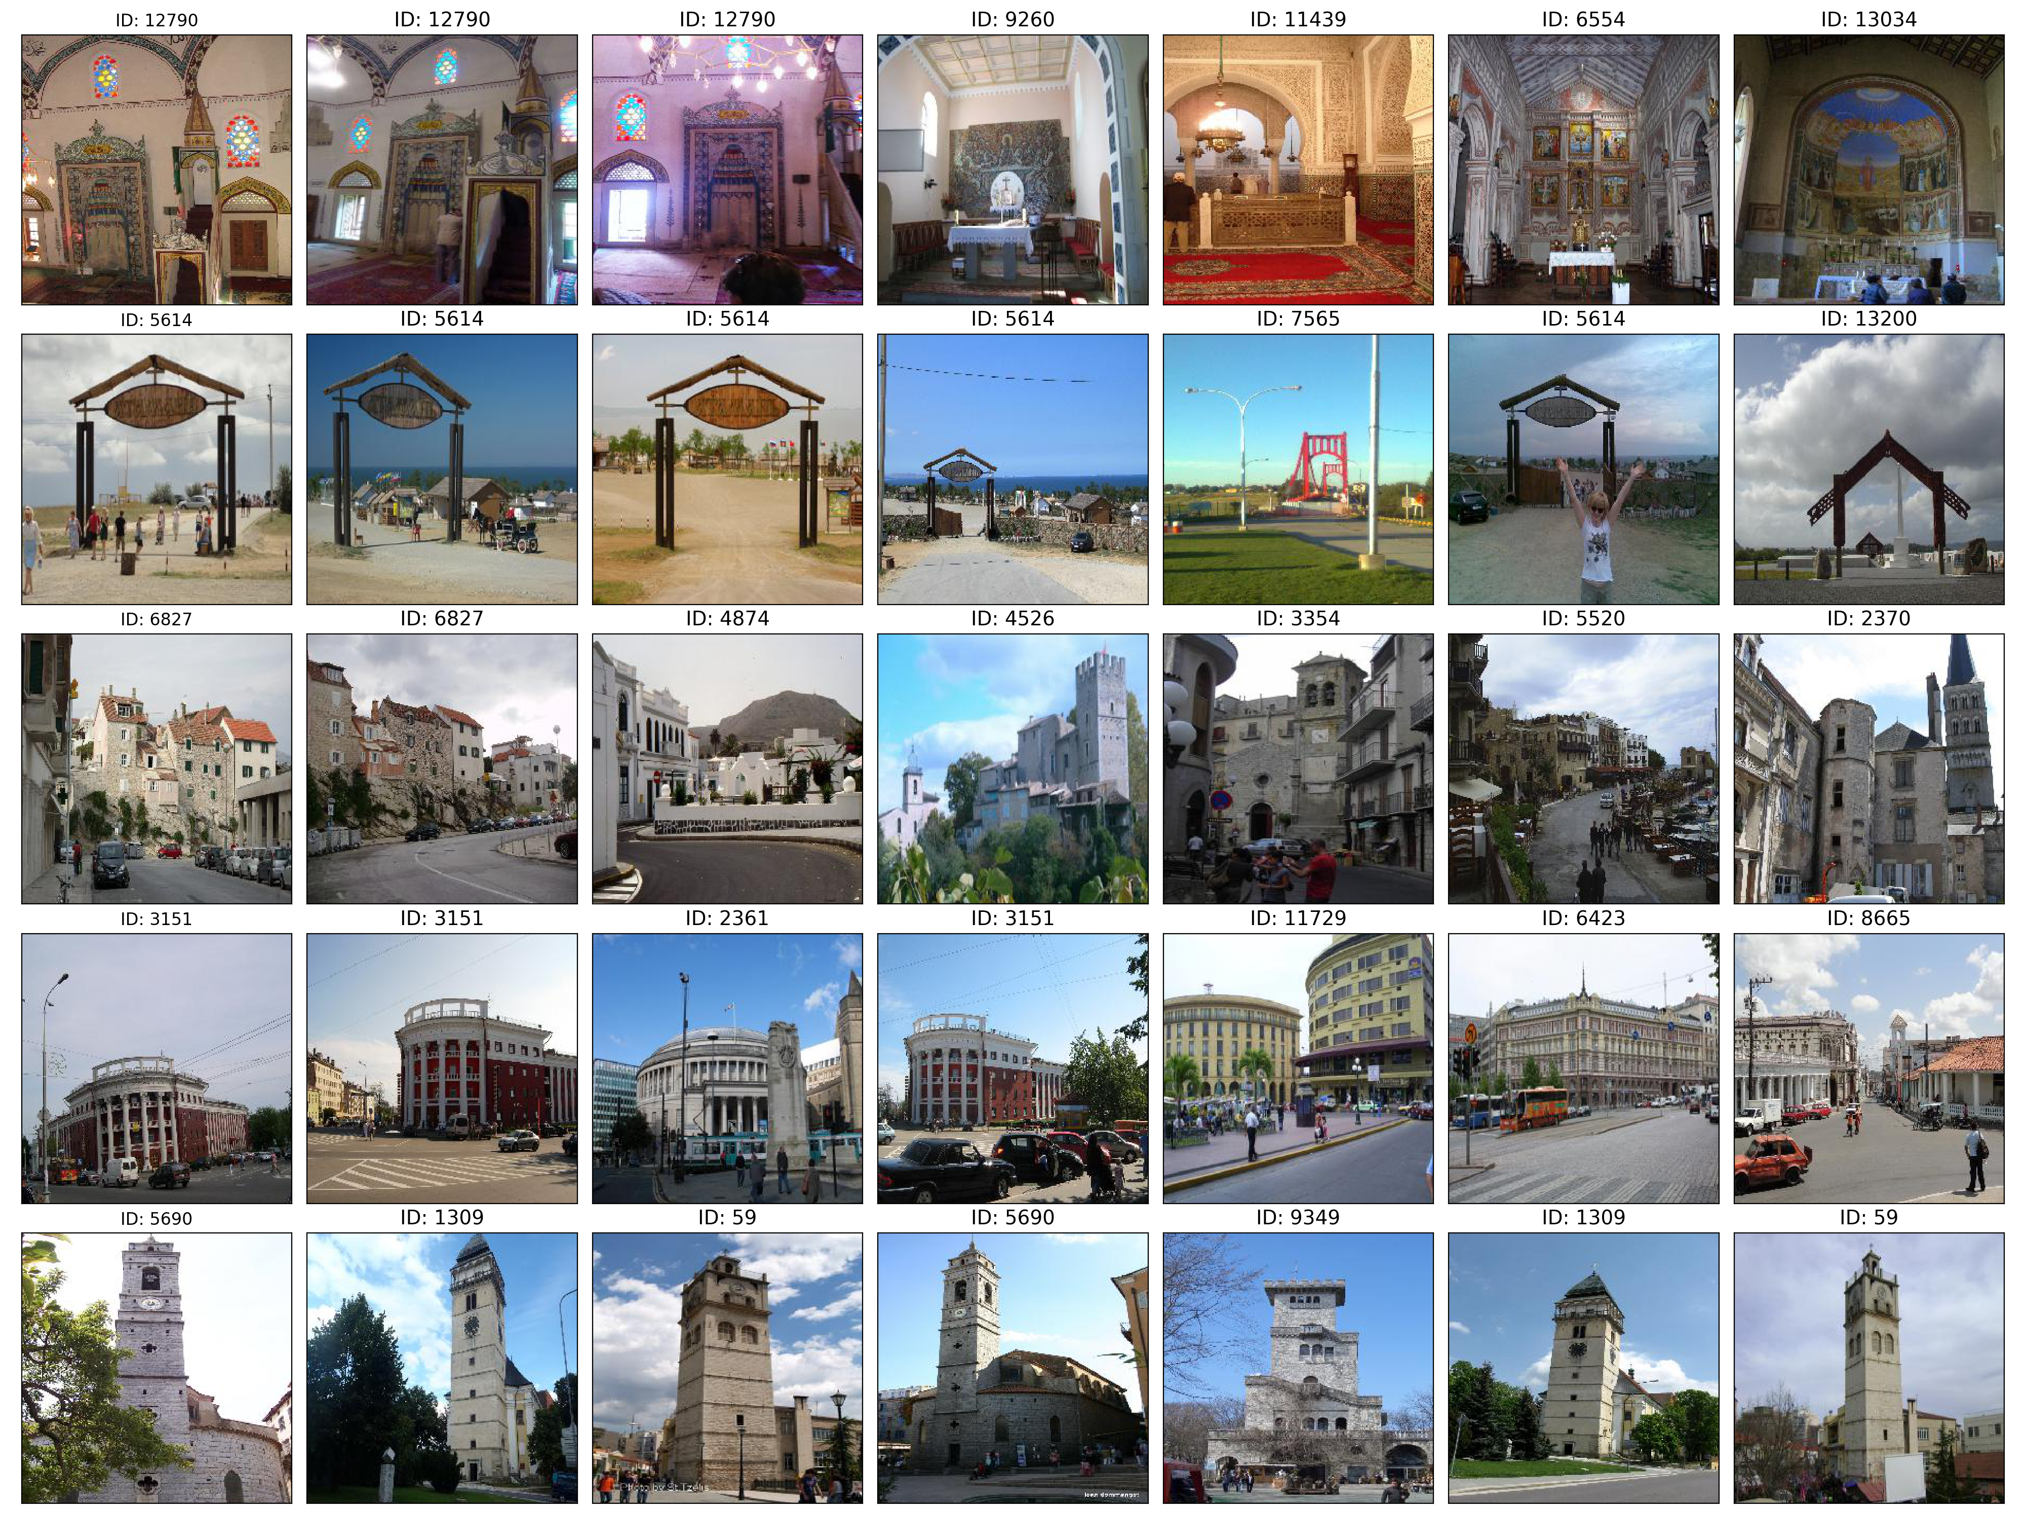
Results
Query
Similar Images

Slide 20
Results
Query
Similar Images

Slide 21
Summary

